Slide 1

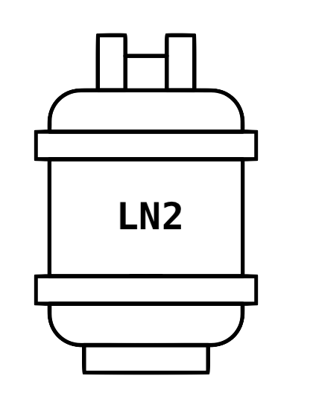



















NMR Laboratory Monitoring
James Tolchard
24th August 2023

Slide 2


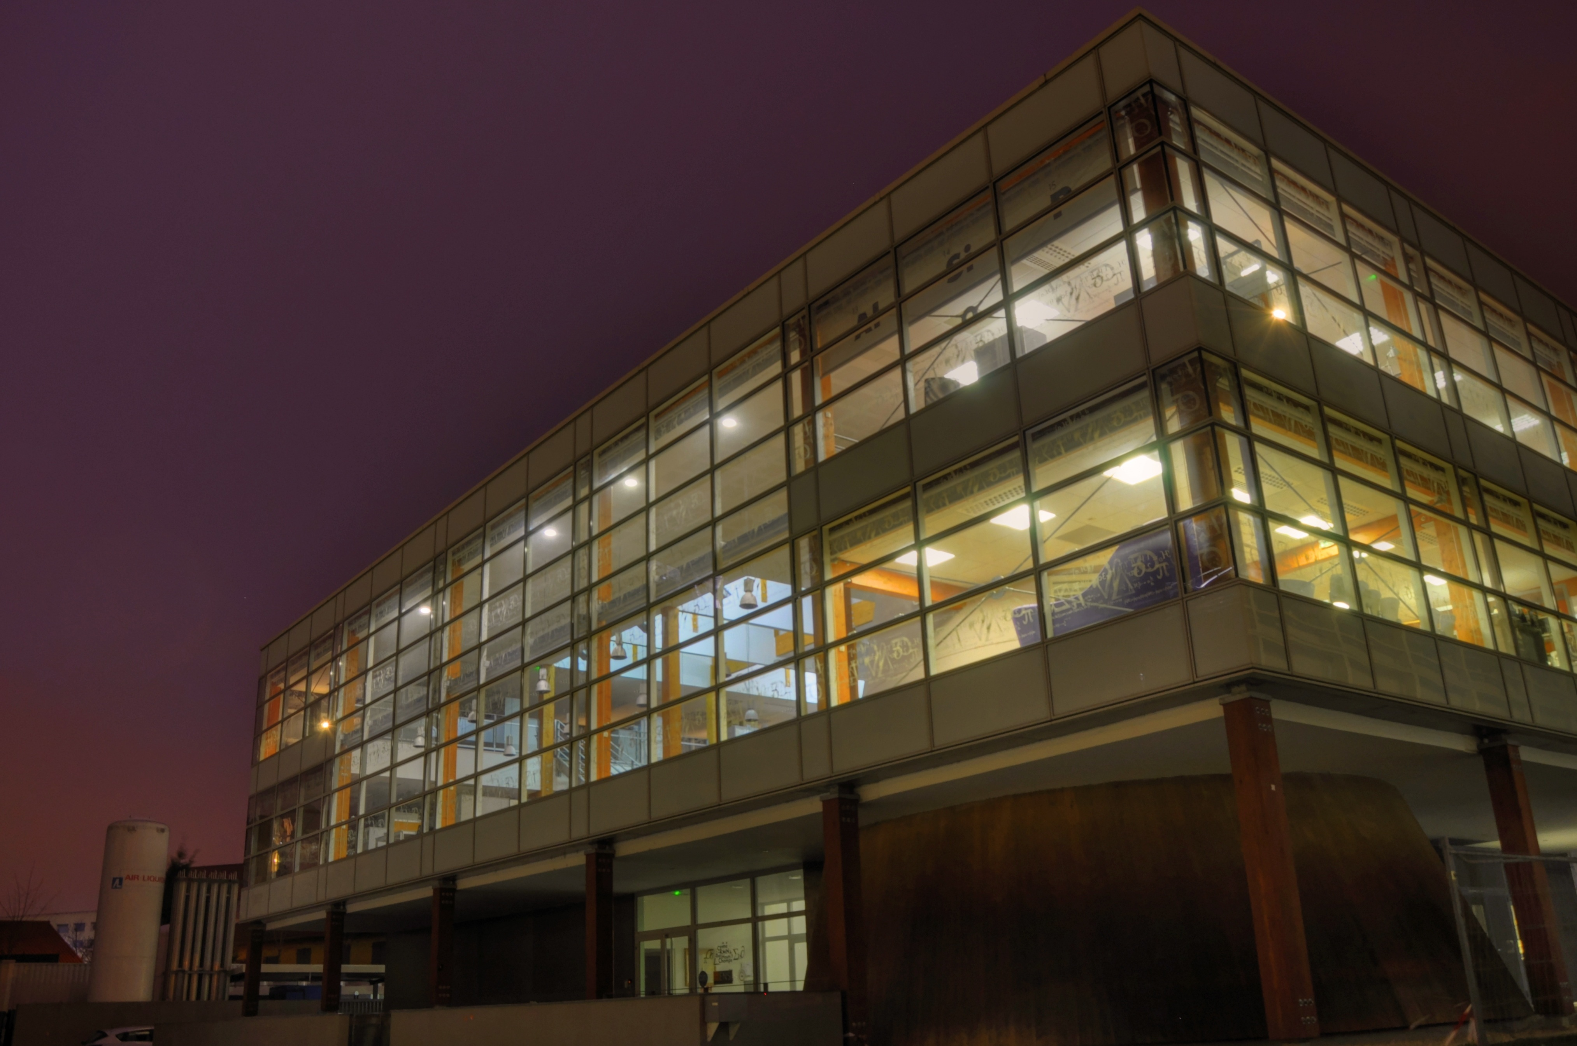
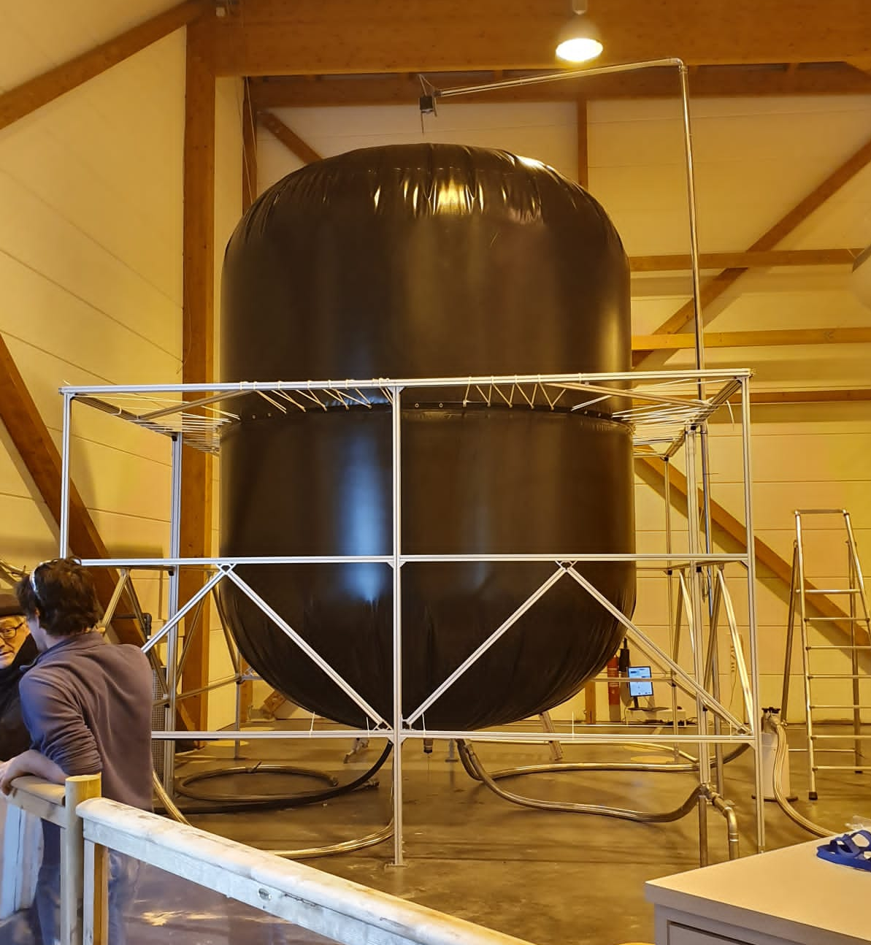
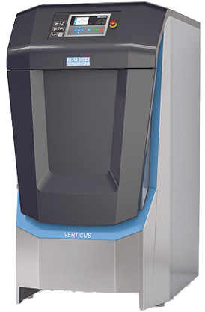

Why ?
- Network Connectivity Issues
- Quantitative Evaluation of Helium Recycling

Slide 3
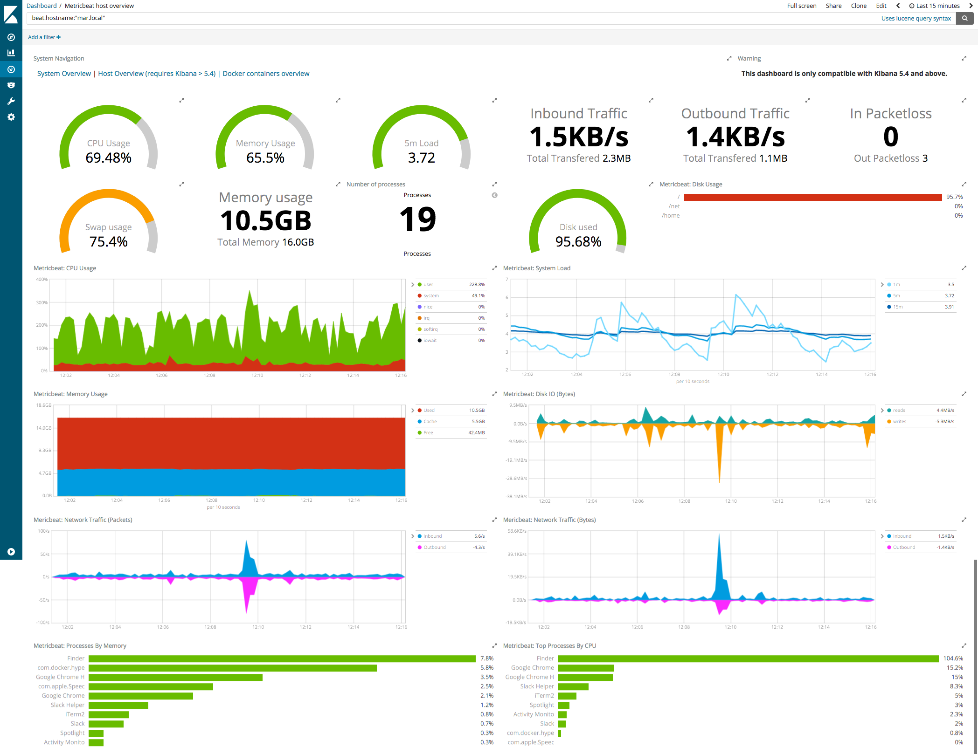









Inspiration
Resource Dashboard
Helps troubleshooting
- Problems / correct departments
Long-term trends
Metric triggers
Preemptive-intervention
Alerts:
Automated comms. (Email/Slack)
Scriptable reactions
Containerization

Slide 4









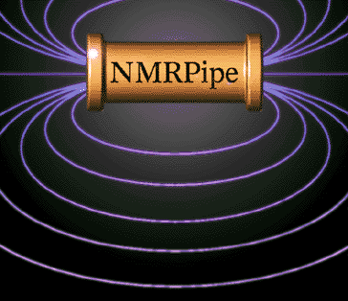











How ? - Containerization
Key requirements
Scalable
Cross-platform
Low Overheads
Fast
Free
Easy to develop
App 1
App 1
Virtual Machine
Bins / Libs
Bins / Libs
App 1
App 1
Container
Guest OS
Guest OS
Bins / Libs
Bins / Libs
Hypervisor
Container Engine
Container Engine
Host OS
Host OS
Infrastructure
Infrastructure

Slide 5





How ? - Containerization
Container Engines / Platforms
Simple / User friendly CLI
Easy to Develop
Straightforward local installation
Community / Documentation / Support
Open source (core) & free to use
Vast Eco-system (100,000+ images)
+ more…

Slide 6

SCANS
Simple Containerized Analysis for NMR Systems
Containers
Time-Series database
Scrapes data over HTTP
Fixed retention time per DB
Cryogen metrics (low res., 2-year retention)
Computer metrics (high res. 2-week retention
CRMN Server

Slide 7



SCANS
Simple Containerized Analysis for NMR Systems
Spectrometer containers
Node Exporter
Collects computer metrics
Spectrometer
Collects MICS metrics
CRMN Server
Non-MICS cryogens
Checks HLMU readings

Slide 8


SCANS
Simple Containerized Analysis for NMR Systems
Web-scraping containers
Accesses Air Liquide APIs for Tank & SPI information
External weather
CRMN Server
Monitors external conditions via API

Slide 9

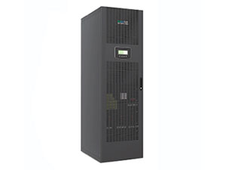
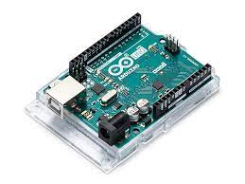
SCANS
Simple Containerized Analysis for NMR Systems
Hardware-scraping containers
Compressor info
Python script creates logs via ModBus comm.
UPS info
Scrapes UPS details via local web-interface
CRMN Server
NMR Hall Env. sensor
Temp, humidity & pressure via custom Arduino API

Slide 10

SCANS
Simple Containerized Analysis for NMR Systems
Hardware-scraping containers
Dell Server Metrics
RAID Storage metrics
Blackbox exporter
Analyses network response times
CRMN Server

Slide 11

SCANS
Simple Containerized Analysis for NMR Systems
Visualization & analysis container
Query Prometheus DBs and create interactive charts and dashboards
Unique user logins and roles (i.e., admin, viewers)
CRMN Server
Create alerts based on metrics and send custom notifications

Slide 12

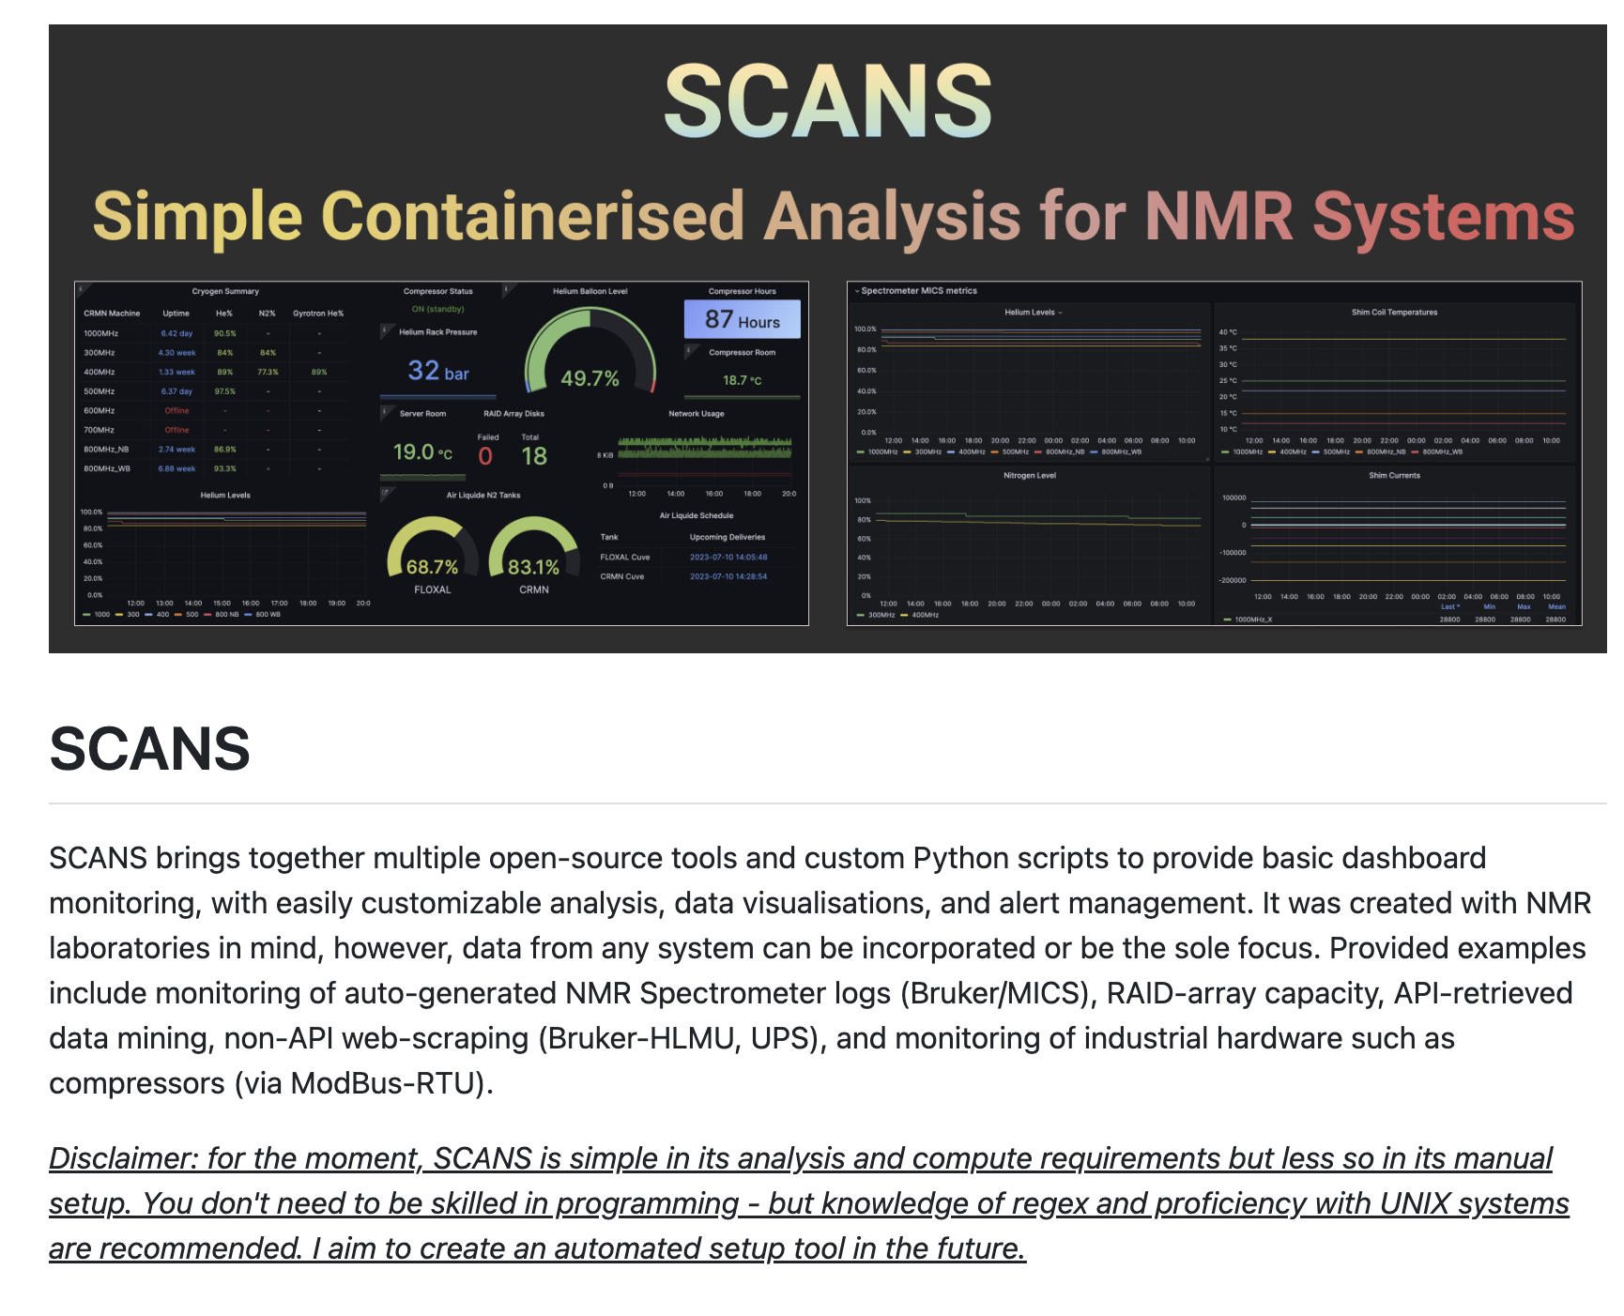
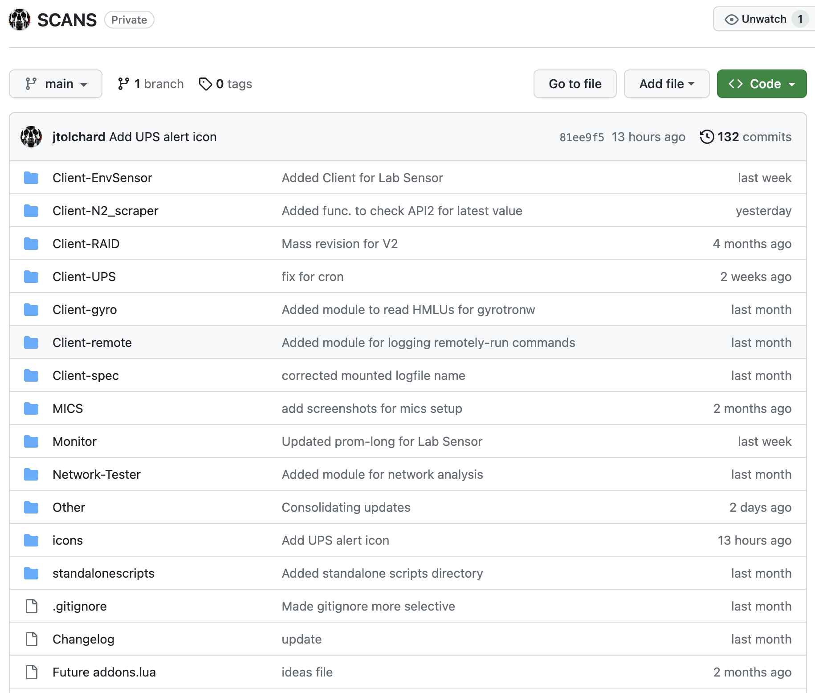
SCANS
SCANS on GitHub (currently private)

Slide 13
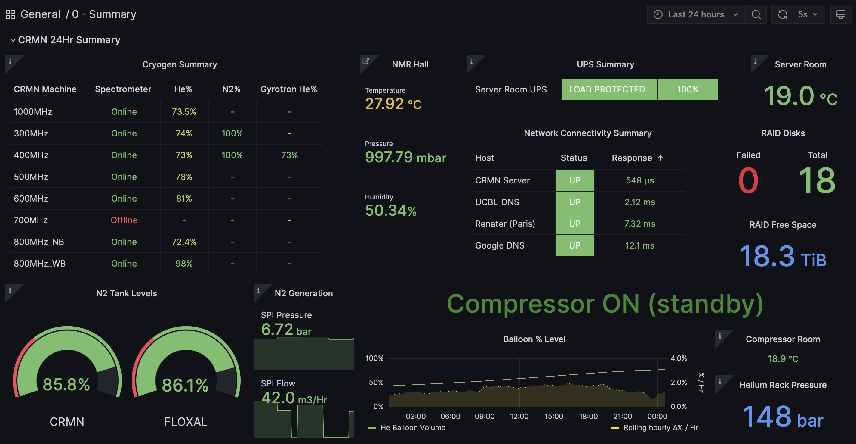
SCANS Dashboard: Summary

Slide 14
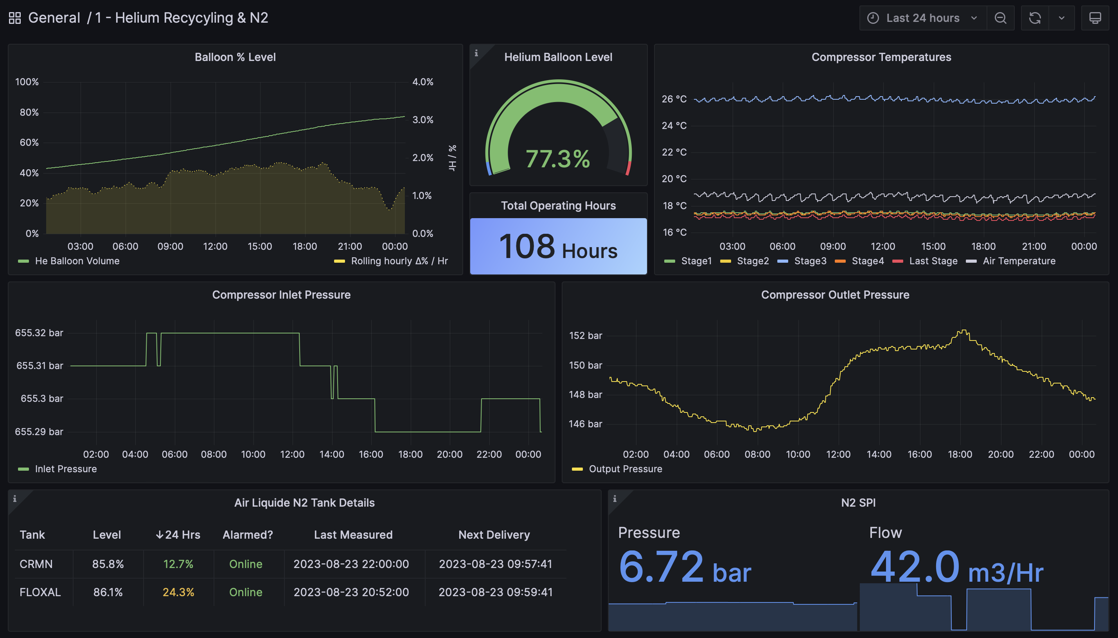
SCANS Dashboard: Cryogen metrics

Slide 15
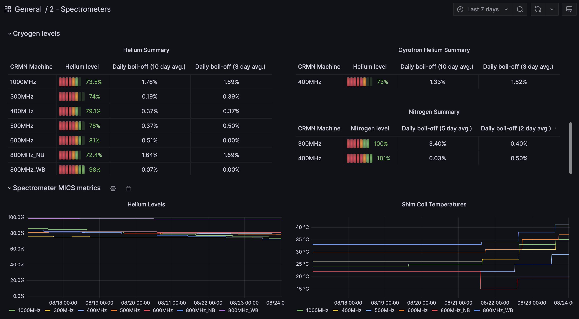
SCANS Dashboard: Spectrometer metrics

Slide 16
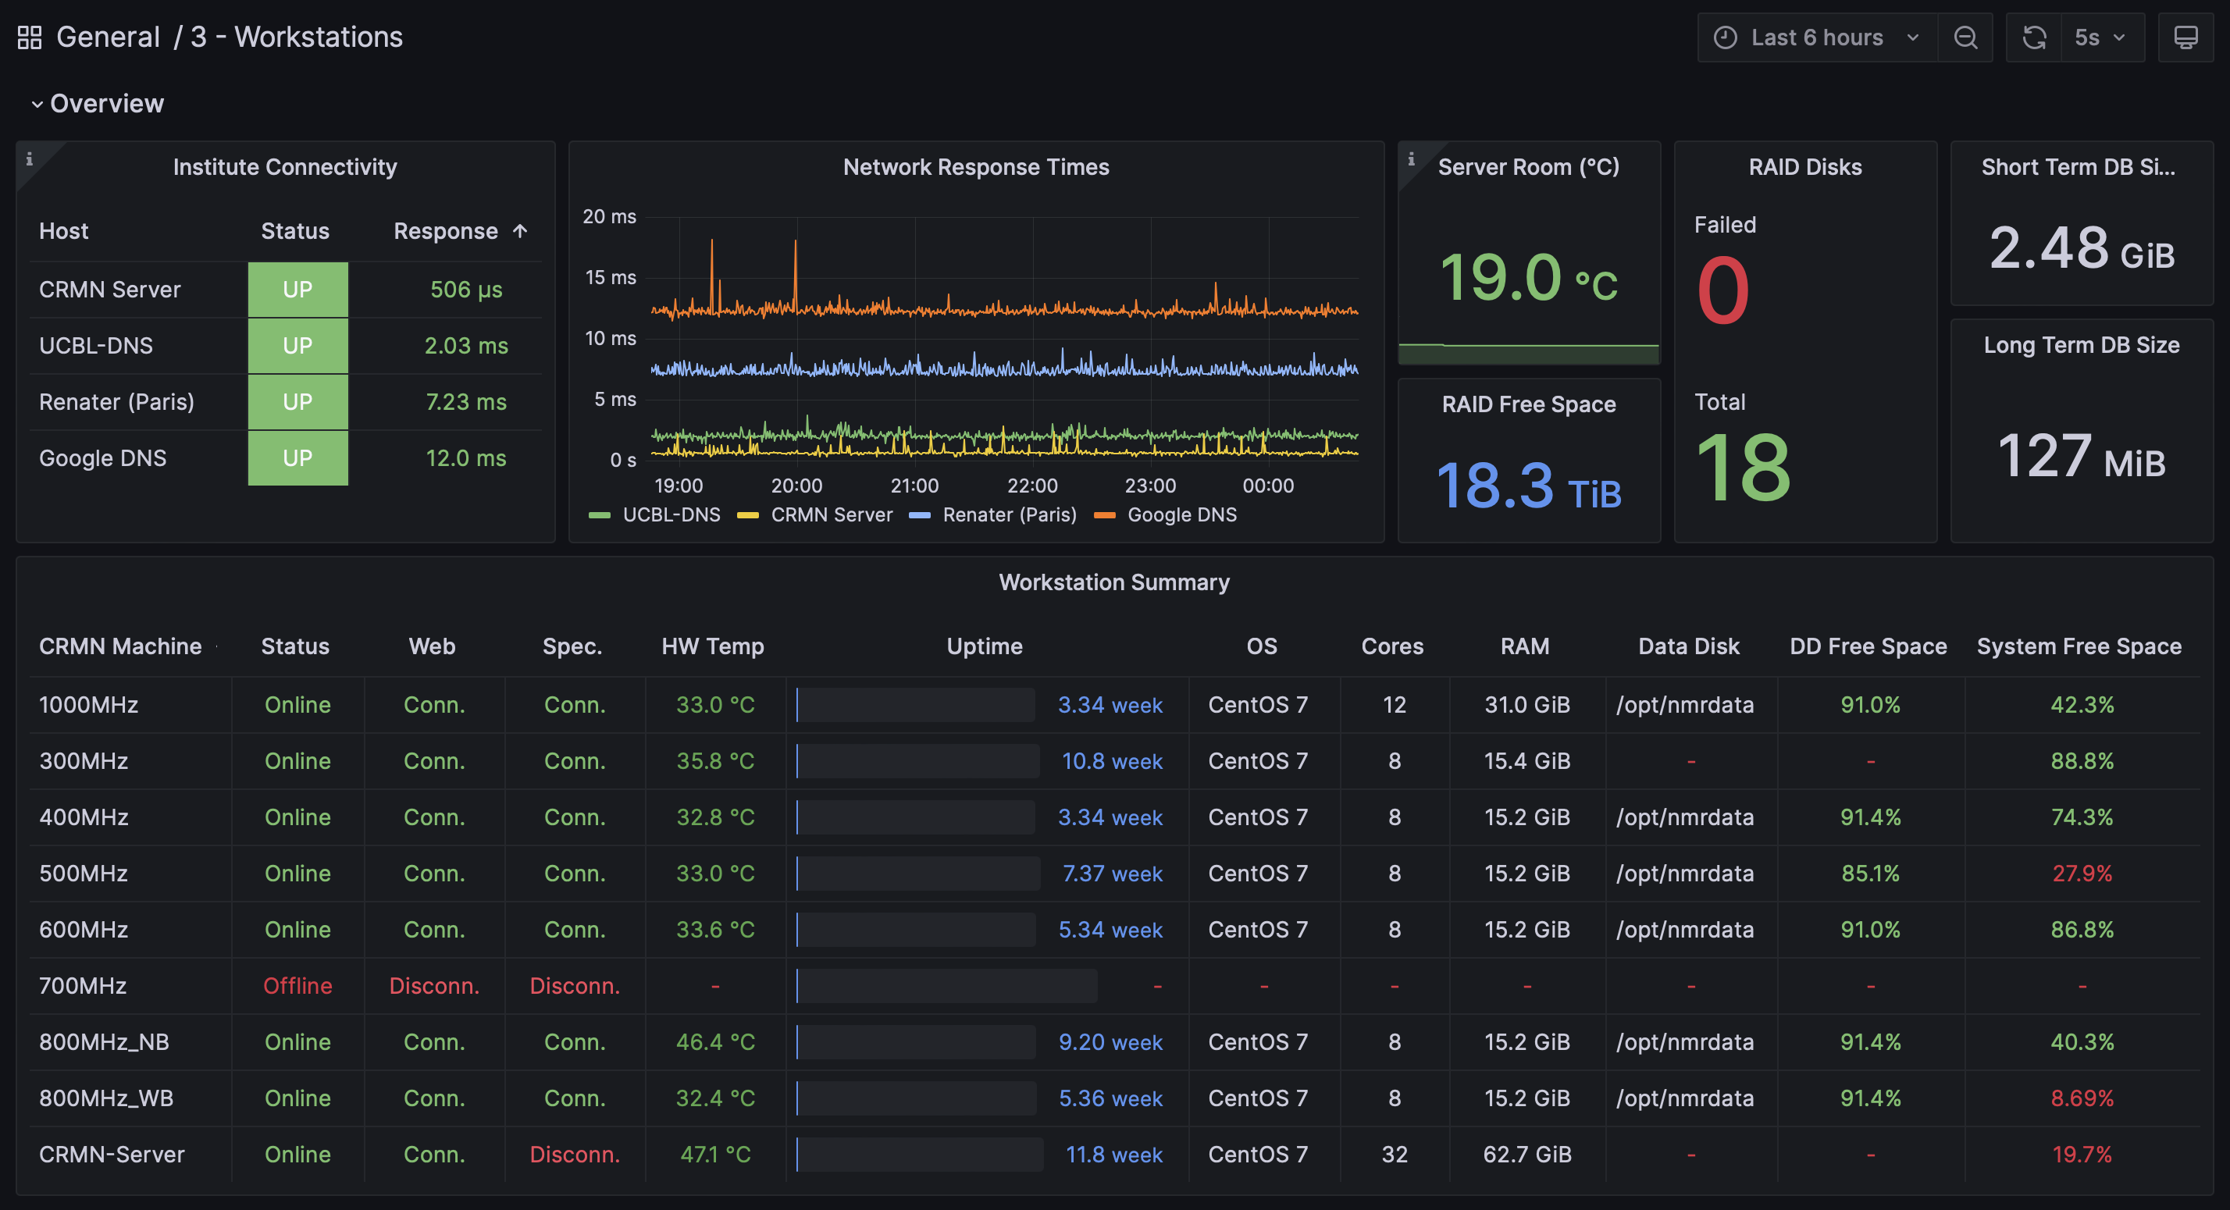
SCANS Dashboard: Workstation metrics

Slide 17
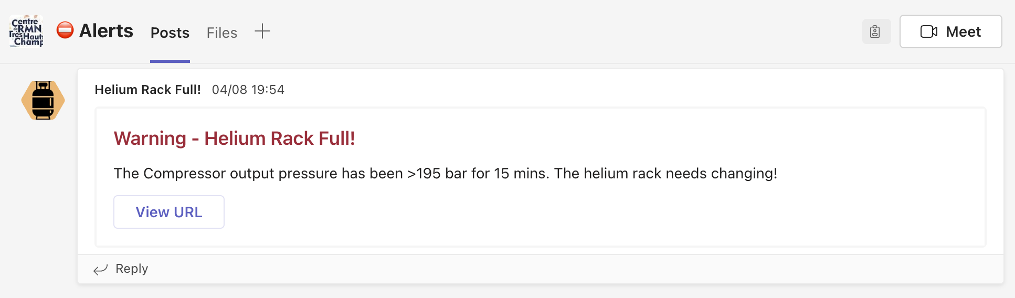
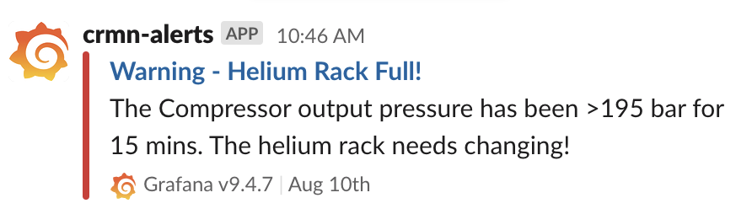
SCANS: Current Automated Alerts
UPS Discharging
Server room air conditioning fail (>30°C)
RAID disk fails
Compressor room air conditioning fail (>30°C)
Helium full – needs changing (>195 bar)
FLOXAL N2 low pressure (<1 bar)
Air Liquide LN2 tanks, high usage (20%/hr)
Air Liquide LN2 tanks, low level (<33%)
Alerts currently sent to custom #alerts Slack & Teams channels

Slide 18
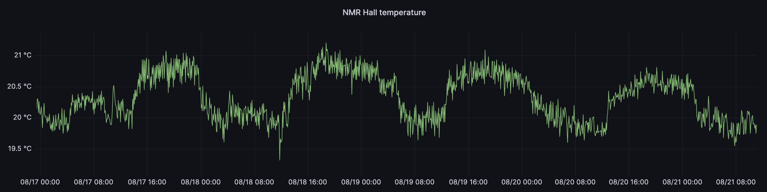
Observations so far…
Normally, NMR hall temp is regulated between ~20-21°C)

Slide 19
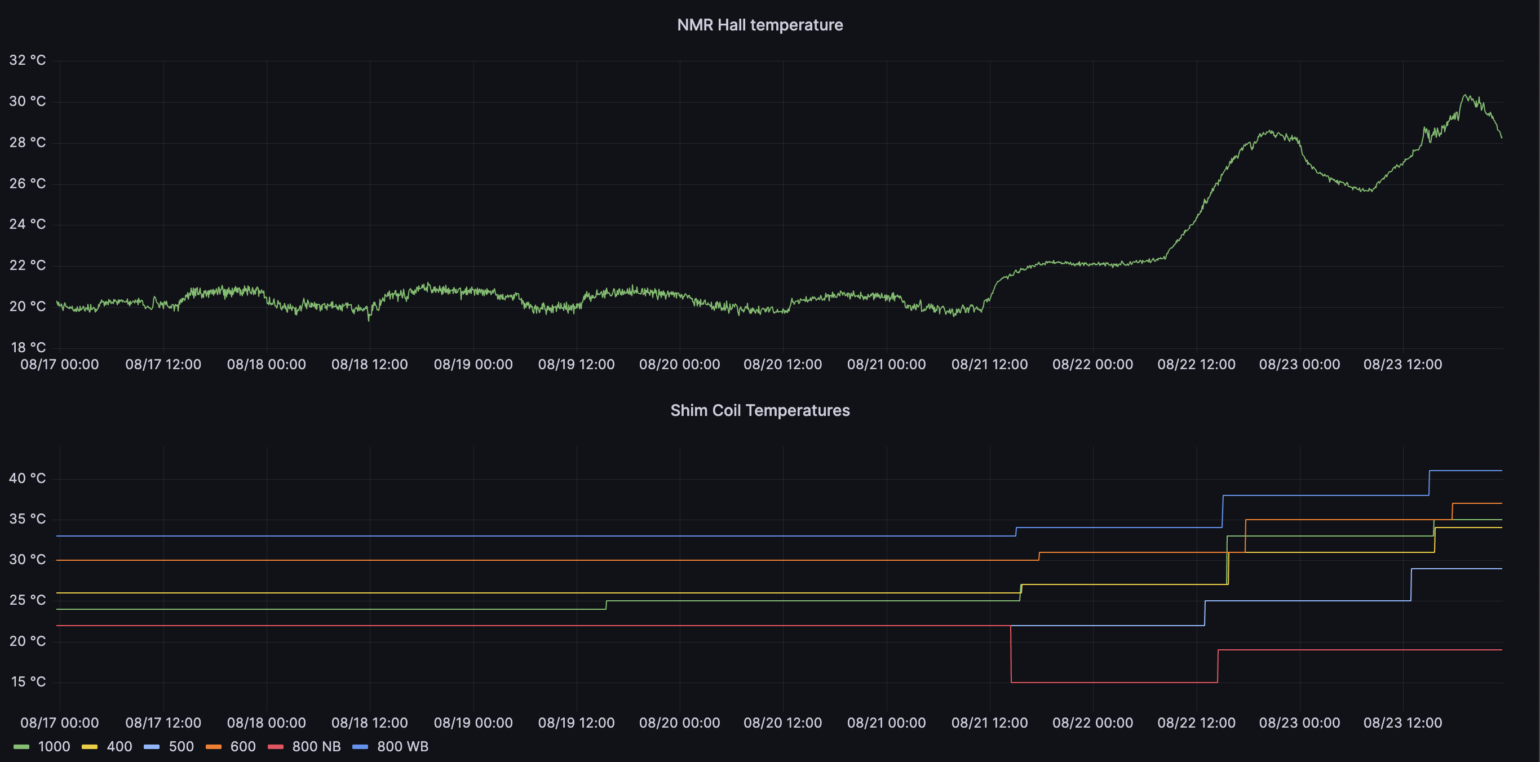
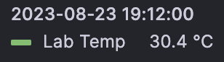
Observations so far…
But, in a heat wave, the Air Conditioning regulation fails… and NMR Hall can reach ~30.4°C!
Spec. | ∆ Shim Temp (°C)
400 | +8
500 | +7
600 | +7
800nb | -3
800wb | +8
GHz | +11
F80 | ? (but lock lost)

Slide 20
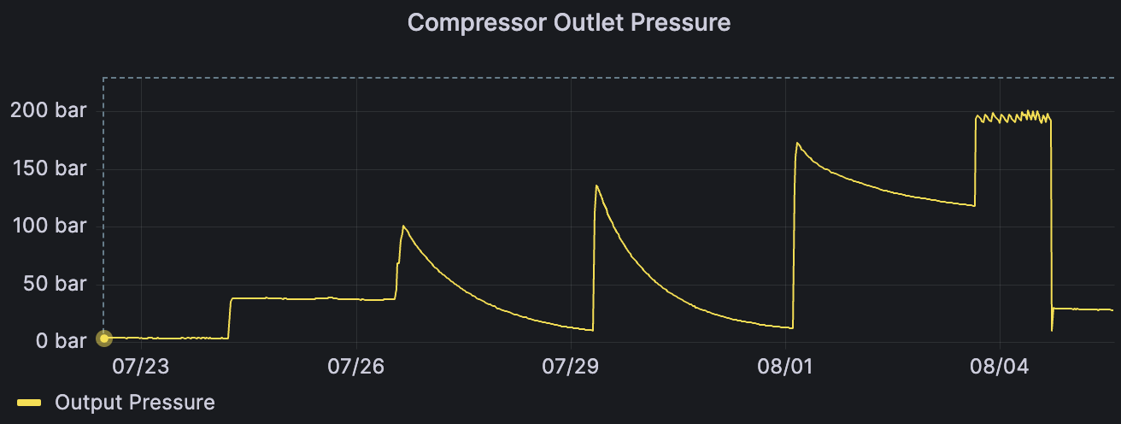
Observations so far…
Humans make mistakes…
- new helium rack connected (but not opened)
26 Hrs

Slide 21
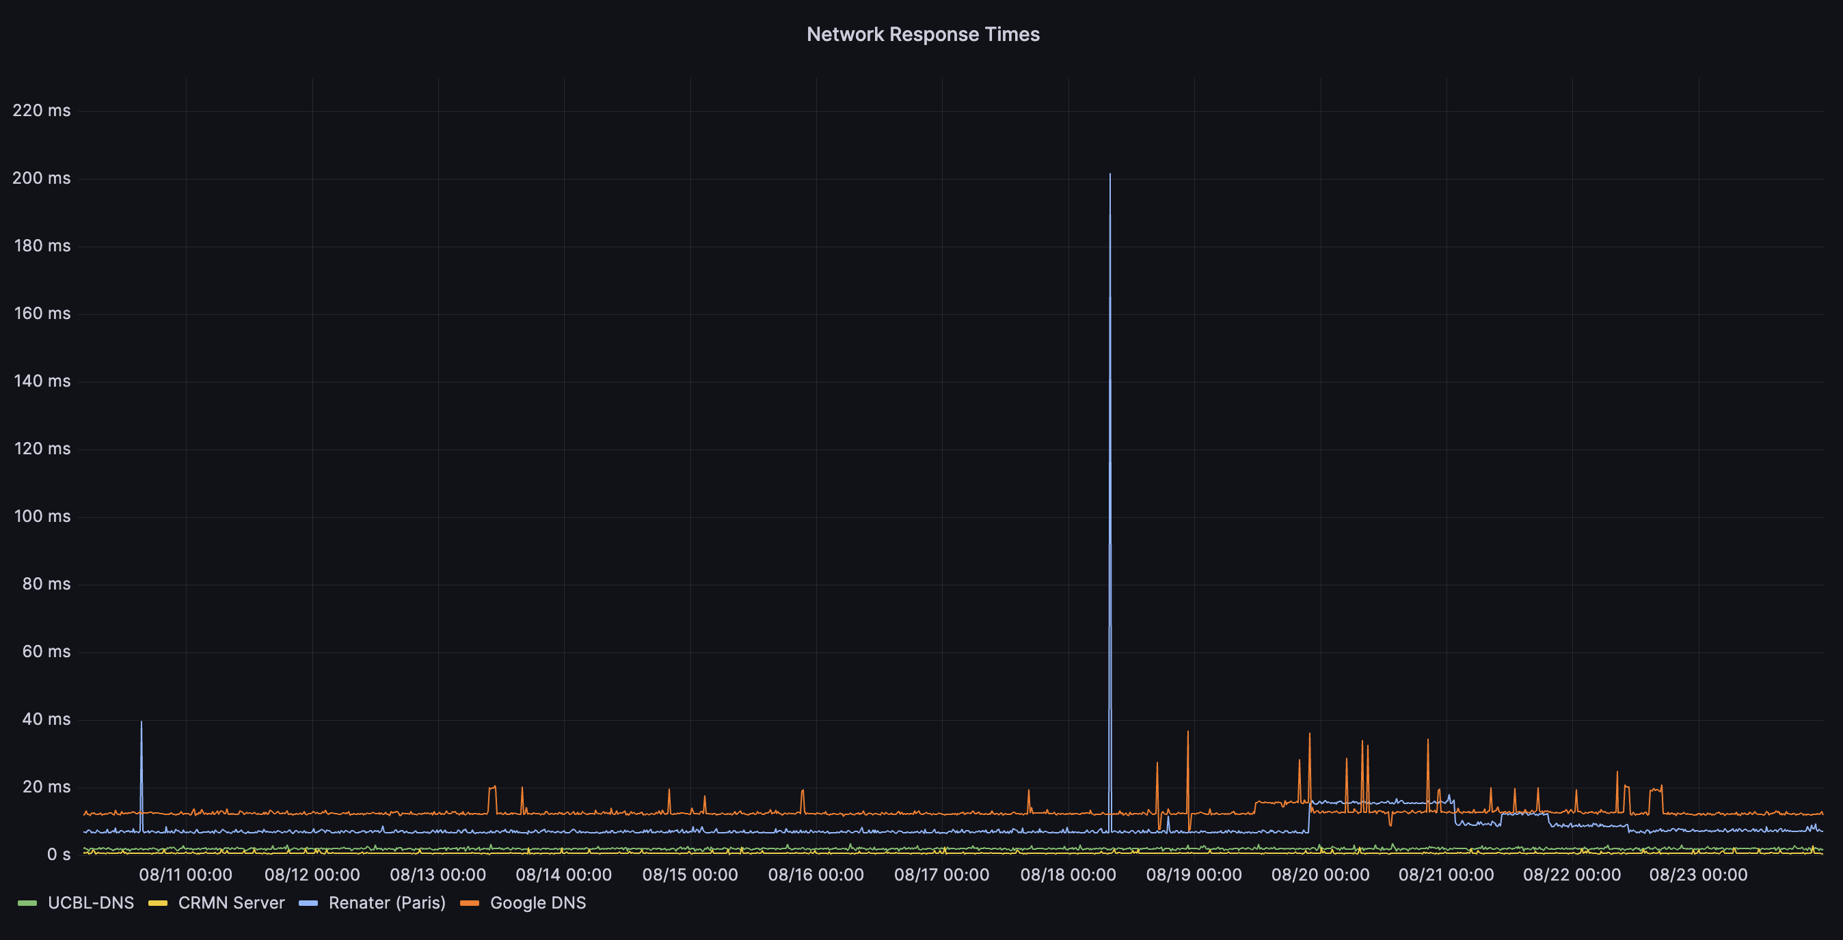
Observations so far…
Our Network connectivity issues seem to be resolved

Slide 22
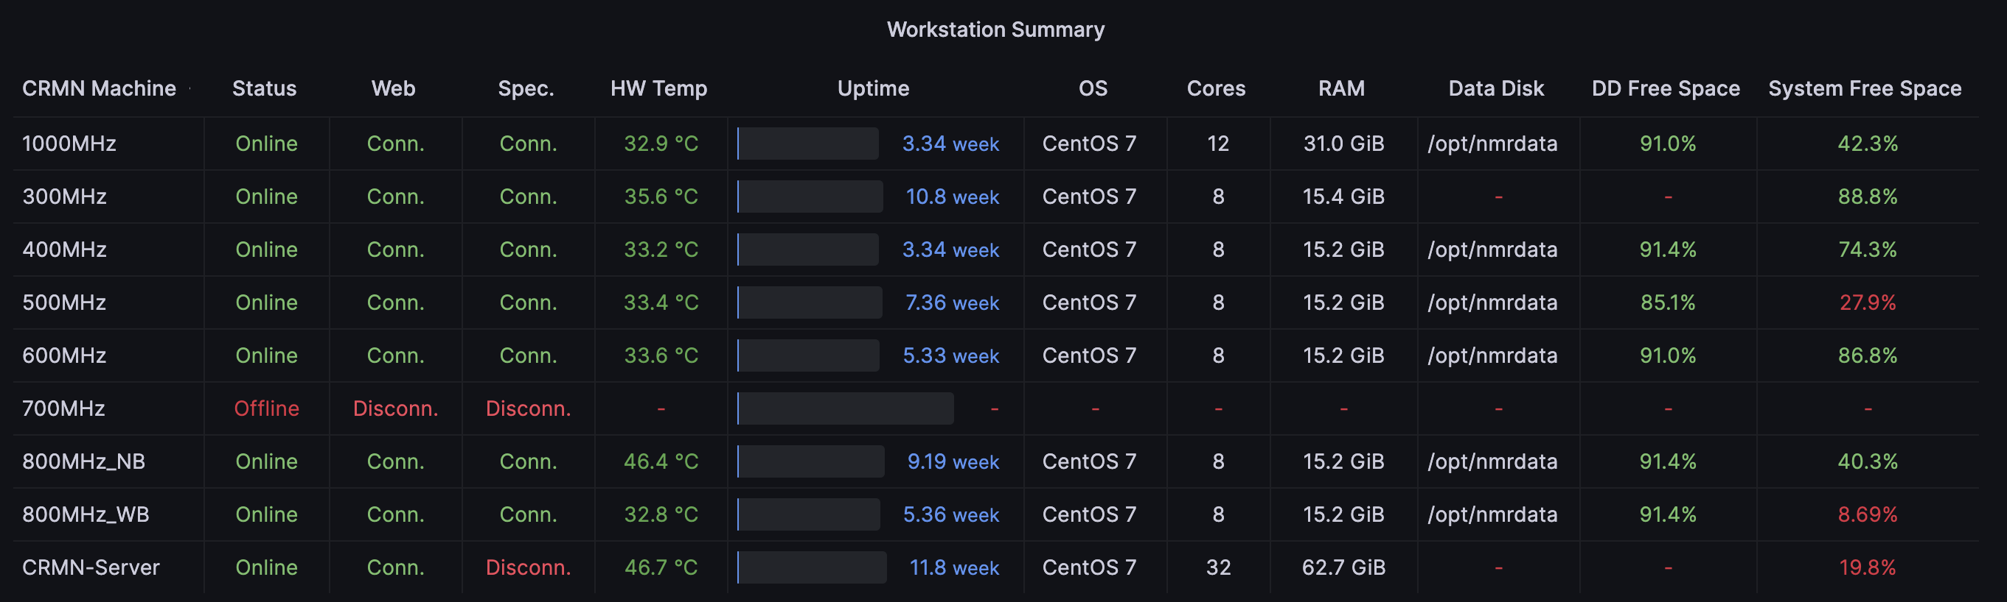
Observations so far…
The Topspin data directories are mounted incorrectly on the 500 MHz and 800 MHz WB
- luckily informed user before summer experiments!

